Slide 1
Data Science Foundations
Víctor Pajuelo
victor.pajuelo@bts.tech

Slide 2

Project Lifecycle
DEFINE data-driven opportunities based on business value creation
UnderstandBusiness
IMPLEMENT & OPTIMIZE data-driven business models
Data collection
IDENTIFY, transform and validate data
Exploit
To lead and manage Big Data projects
Smart
Data
Analysis & Visualization
DEVELOP & TRAIN intelligent data algorithms
DEVELOP analytical and data visualization techniques

Slide 3
Project Lifecycle
Data-Driven Business
Creative Technology
Entrepreneurship
Big Data legal & Security
Agile
UnderstandBusiness
Data-Driven Business
Data Science Foundations
Infrastructure
Real-time Data Analysis
Big Data legal & Security
Agile
Data-Driven Business
Advanced Data Analysis
Infrastructure
Real-time Data Analysis
Big Data legal & Security
Agile
Data collection
Exploit
To lead and manage Big Data projects
Data-Driven Business
Data Visualization
Advanced Data Analysis
Artificial Intelligence
Infrastructure
Big Data legal & Security
Real-time Data Analysis
Agile
Smart
Data
Analysis & Visualization
Data-Driven Business
Data Science Foundations
Classical Data Analysis
Infrastructure
Real-time Data Analysis
Big Data legal & Security
Agile

Slide 4
Data Science Foundations
What we will learn
We’ll learn how to collect, clean, process, manipulate, understand and visualize our data to accomplish our business objectives.
We will learn:
Practical Data Manipulation in Python
Basic data operations on relational data
Loading and filtering text
Loading and preprocessing images
Data Manipulation
Basic Data Analysis
The process of data analysis
Structured data types
Overview of main analytic techniques
The basics of putting a model into production

Slide 5
Student Experience
Industry congresses
Meetups
Keynotes
Visits to companies
BTS DEMO
DAY
DIGITAL ECOSYSTEM
EXPERIENCE
A
ACADEMIC EXPERIENCE
B
Z
20%
100%
OF THE STUDENT EXPERIENCE
OF THE STUDENT EXPERIENCE
WORK ON YOUR PURPOSE - RESEARCH – DISCOVER –
BUILD NETWORKING – JOIN COMMUNITIES –
PARTICIPATE – GENERATE PUBLIC CONTENT

Slide 6
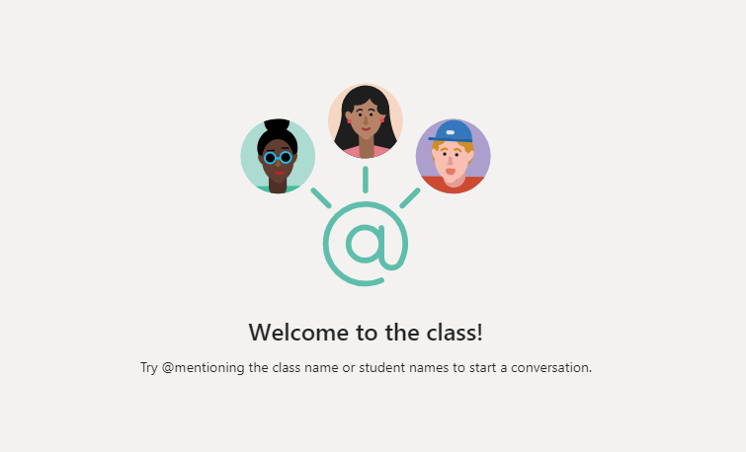
Curriculum review

Slide 7

A little bit about me

Slide 8
Introducing the course

Slide 9
Part I. Practical Data Manipulation in Python
1. Basic data operations on relational data (Pandas Introduction)
Recap of input/output and on-disk formats
Cleaning noisy data, normalizing
Filtering rows and columns
Joining data from multiple sources
Split-apply-combine workflows: groupby
2. Loading and processing images and text
Image loading, pre-processing and filtering
Image pre-processing for object detection and segmentation
Text pre-processing, normalization, stemming, stopword removal
Converting text to vectors and computing text similarity
3. Date manipulation
Basic data types, timezones
Resampling, shifting and windowing

Slide 10
Part II. Basic Data Analysis
4. The process of data analysis
Exploratory data analysis and insights finding
Feature engineering
5. Data types
Image processing
Time series analysis
Text processing
6. Overview of main analytic techniques
Regression on time-series, text and images
Classification on text and images

Slide 11
Part III. Data Science in production
7. The process of ETL (Extract Transform Load)
Data gathering and scraping
8. Packaging your model
Model evaluation and deployment
Containerize the model
9. The last mile to user: visualization and delivery
Visualization and reporting
Common delivery platforms

Slide 12
About the teaching methodology

Slide 13
Teaching methodology
Three sessions of one and a half hours per day, divided in:
Theory (usually supported by notebooks)
Theory (usually supported by notebooks)
In-class exercises (supported by notebooks)
One assignment per week presented on Thurday’s class and due next Thursday..
Using the first 30 minutes of every Thursday class to comment the solutions.
Using this git repository for notebooks

Slide 14
Today’s class

Slide 15
Today’s Objective
Understand the basic abstractions of pandas
Series, DataFrames and Indexes
Explore techniques to read standard text files
Learn how to do basic data exploration
Do basic analytics with pandas
Why is this useful for a digital project?
Understanding data manipulation is crucial for any data science project

Slide 16
Contents
1. Basic data operations on relational data (Pandas Introduction)
Recap of input/output and on-disk formats
Cleaning noisy data, normalizing
Filtering rows and columns
Joining data from multiple sources
Split-apply-combine workflows: groupby

Slide 17
Pandas introduction

Slide 18


Pandas
Python Data Analysis library
This Photo by Unknown Author is licensed under CC BY-SA
This Photo by Unknown Author is licensed under CC BY-SA

Slide 19

Pandas
Python Data Analysis library
Pandas is a Python package providing fast, flexible, and expressive data structures designed to make working with “relational” or “labeled” data both easy and intuitive.
It aims to be the fundamental high-level building block for doing practical, real world data analysis in Python.
Additionally, it has the broader goal of becoming the most powerful and flexible open source data analysis / manipulation tool available in any language.
Built on top of NumPy!
Source

Slide 20
Pandas
Data Suitability
Tabular data with heterogeneously-typed columns, as in an SQL table or Excel spreadsheet
Ordered and unordered (not necessarily fixed-frequency) time series data.
Arbitrary matrix data (homogeneously typed or heterogeneous) with row and column labels
Any other form of observational / statistical data sets. The data actually doesn’t need to be labeled at all to be placed into a pandas data structure
Source

Slide 21
Pandas
Why pandas is very adequate for data analysis?
Easy handling of missing data (represented as NaN) in floating point as well as non-floating point data
Size mutability: columns can be inserted and deleted from DataFrame and higher dimensional objects
Automatic and explicit data alignment: objects can be explicitly aligned to a set of labels, or the user can simply ignore the labels and let Series, DataFrame, etc. automatically align the data for you in computations
Powerful, flexible group by functionality to perform split-apply-combine operations on data sets, for both aggregating and transforming data
Easy conversion of different formats: differently-indexed data in Python and NumPy data structures into DataFrame objects

Slide 22
Pandas
Why pandas is very adequate for data analysis?
Intelligent label-based slicing, fancy indexing, and subsetting of large data sets
Intuitive merging and joining data sets
Flexible reshaping and pivoting of data sets
Hierarchical labeling of axes (possible to have multiple labels per tick)
Robust IO tools for loading data from flat files (CSV and delimited), Excel files, databases, and saving / loading data from the ultrafast HDF5 format
Time series-specific functionality: date range generation and frequency conversion, moving window statistics, moving window linear regressions, date shifting and lagging, etc.

Slide 23
Pandas
Main data structures
Series
0.25 | 0.5 | 0.75 | 1.0
Value mutable / Size immutable
Index
A | B | C | D
Value inmutable / Size immutable
 | columns
A | 0.25
B | 0.5
C | 0.75
D | 1.0
DataFrame
Value mutable / Size mutable

Slide 24
Pandas
Main data structures can be understood as:
Series | DataFrames | Index
As a 1-D NumPy array | As a 2-D NumPy array | As an immutable array
As a specialized Python dictionary | As a specialized Python dictionary | As an ordered set
 | As a single Series on a DataFrame
 | As a structured list of dicts
 | As a dictionary of Series objects

Slide 25
Pandas
Data Structures in code!
Go to the notebook here

Slide 26
Pandas functionality introduction
and
Class exercise

Slide 27
Pandas
Intro in code!
Go to the notebook here

Slide 28


